Slide 1

Interactive Automated Chess Set
Group 4:
Brett Rankin
Paul Conboy
Samantha Lickteig
Stephen Bryant

Slide 2
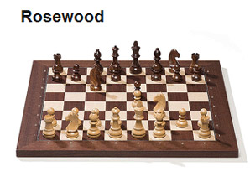
Goals
To create a portable interactive chess board where gameplay will be fully automated.
Each piece will be moved by a claw suspended above the board
Person vs. Computer game play

Slide 3
Specifications
90% chess piece movement accuracy
Total weight <100 lbs
Able to be lifted by two people
12”x12” playing grid

Slide 4
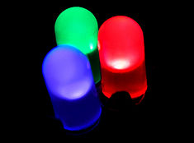
Features and Functions
LED lights will be used to light up the squares on the board
Individual squares, communication with the user(s)

Slide 5

Features and Functions
Player modes:
1.) Player vs. Computer
2.) Player vs. Player
3.) Computer vs. Computer

Slide 6
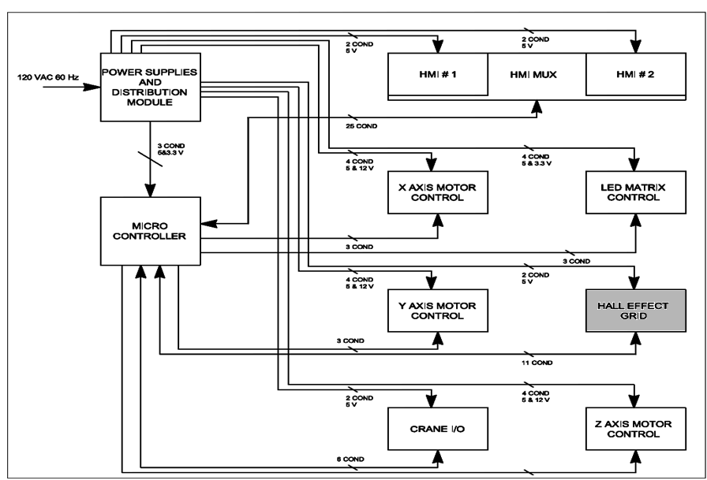
Block Diagram

Slide 7
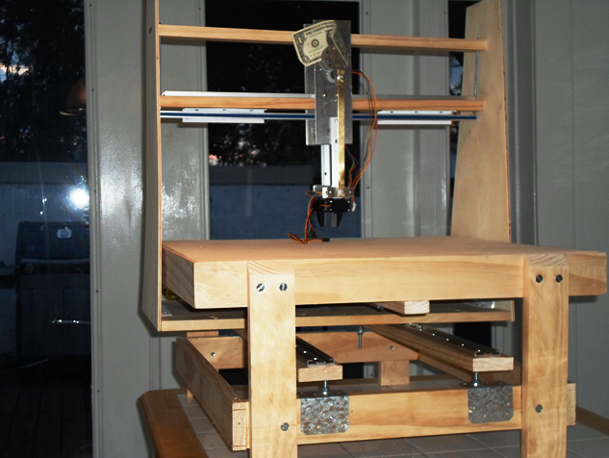
Physical Chess Table

Slide 8
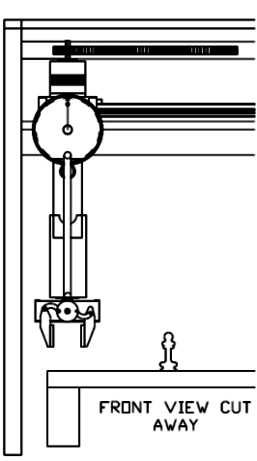
Mechanical
Three Motion Axis
One Gripper
Sliding A Frame Structure
Overhead Gantry
Stability and Consistent Repeatable Motion Control Needed

Slide 9
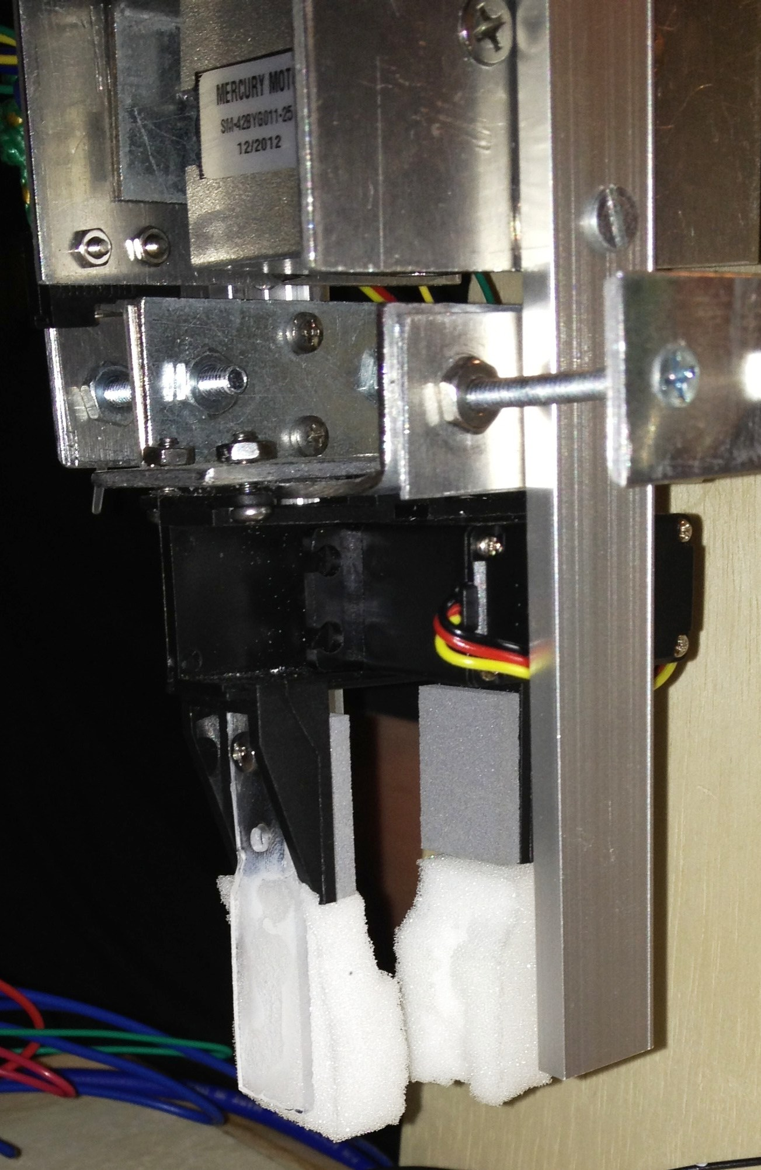
Gripper Claw
Purchase gripper and servo this was not a design item
One Micro Controller I/O output to command gripper open and closed
Pulse width command signal with a 20 ms period. The pulse on time will vary to open and close the gripper.
Modified gripper, added fingers and memory foam.

Slide 10
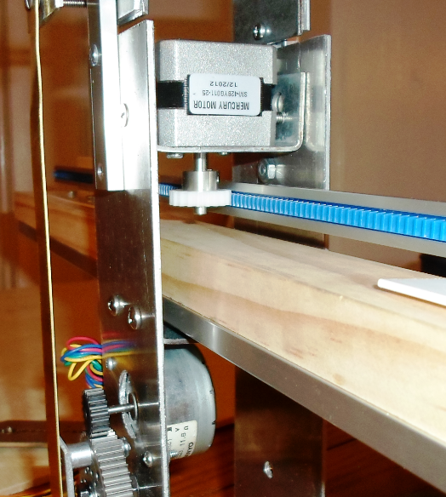
Stepper Motors
Three 12 Volt Bi-polar Stepper Motors.
Torque Value for X,Y,& Z Axes rated at 2.4Kg*cm
The Y Axis (moves the A frame structure) needed more torque, so we set it the full step mode.
The X and Z axes are set for half step mode. This is a trade off for smother quieter operation.

Slide 11
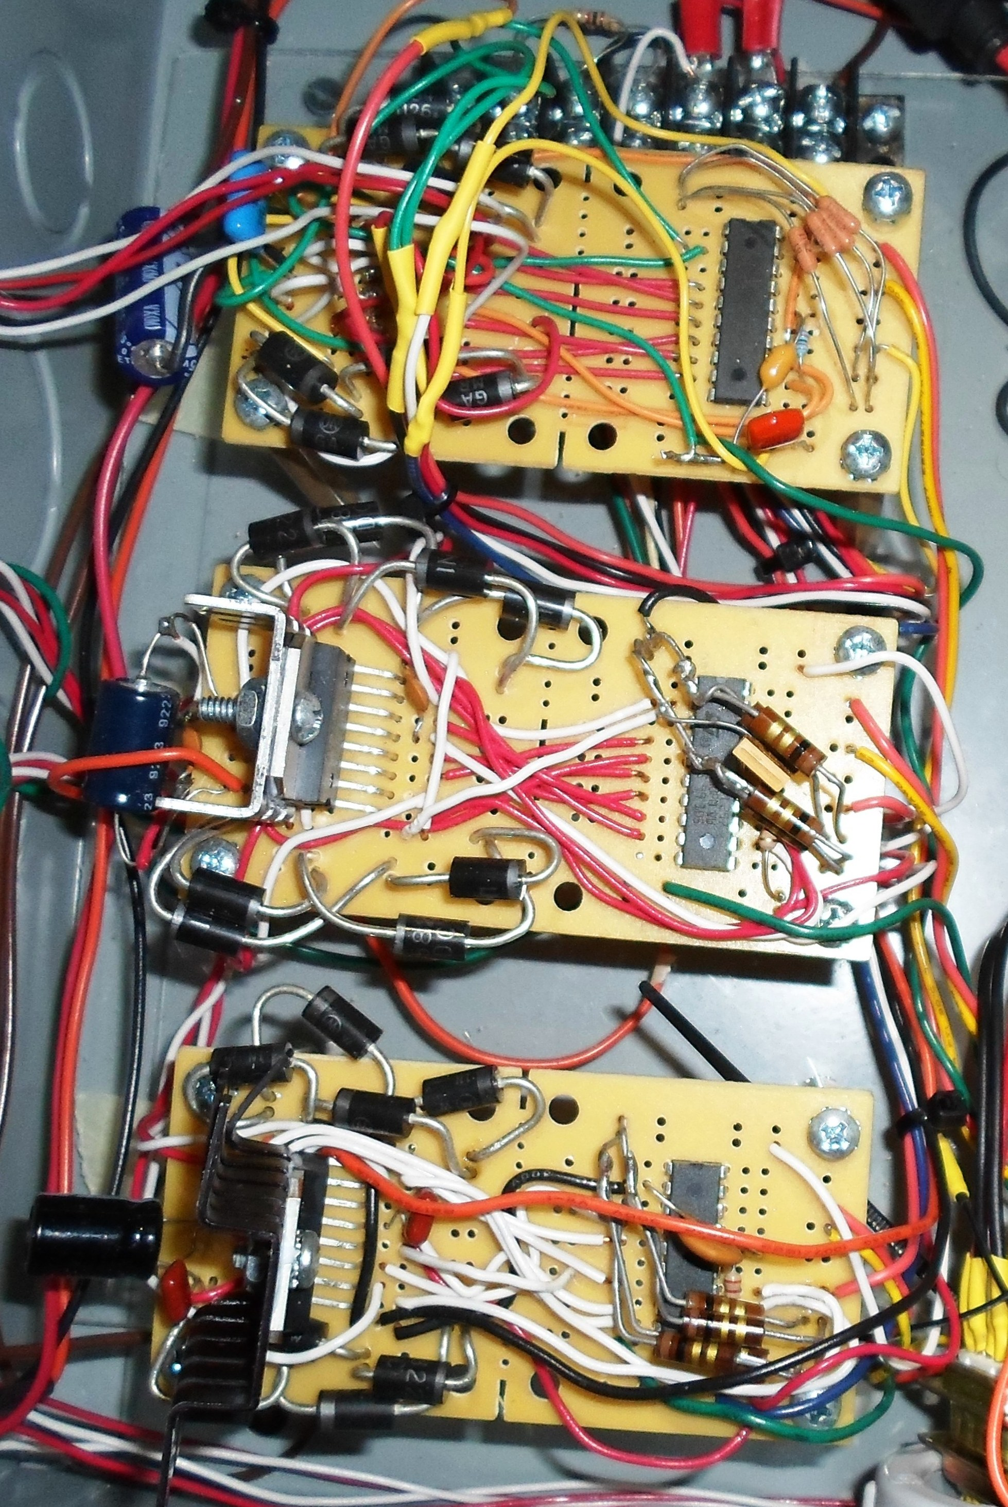
Motor Control
Design Goals
Single Modular Design for all Three Axes
Easy to bread board Avoid surface mount technology
Must be practical to install heat sink
Minimize micro controller I/O count. Three outputs per controller.
Based on proven reference design

Slide 12
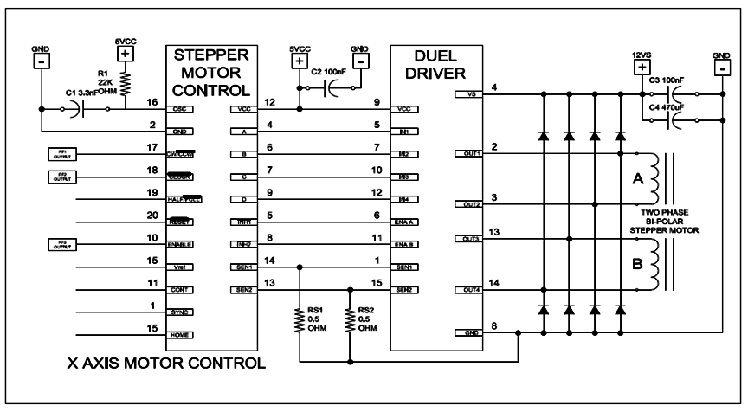
Motor Control Schematic
L297
L298

Slide 13
Stepper Resolution
Each step equals 1.8 degrees of angular displacement.
200 steps per revolution
No feedback needed with stepper motors
X and Y axes have the same size spur and rack gears, so the scaling is the same
Z axis needs 1½ revolution of the large gear.
Calculated 1REV = 1.978in 1Step ≈ .01in
Measured (Y axis) 124 steps = 1.5 inches

Slide 14
Motion Control Circuits
X and Y Axes Over travel switches in the E-Stop chain.
E-Stop Switch
X,Y and Z Axes Home limit switches to provide the micro controller with a starting reference.
The gripper did not need position sensing due to mechanical design. No signal = Open position.

Slide 15
LED Grid
Purpose:
The grid of LEDs have a dual function, to add a lighting aesthetic to the board and visual cues for the player based on what is happening in the game.
The board itself does not have painted on black and white squares, like most chess boards, but rather it has the LEDs under the board turn on or off in a checkerboard pattern to make the distinction between squares.
The LEDs blink to indicate the position of where the piece is coming from and heading to.

Slide 16
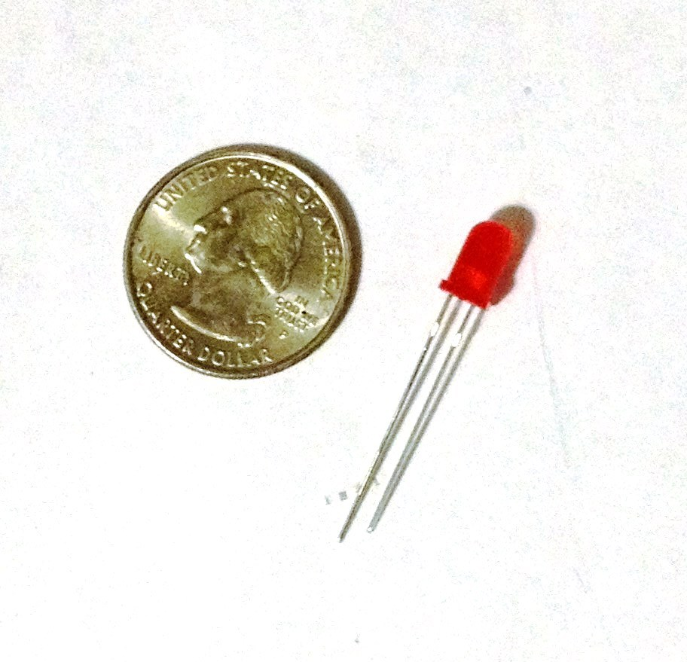
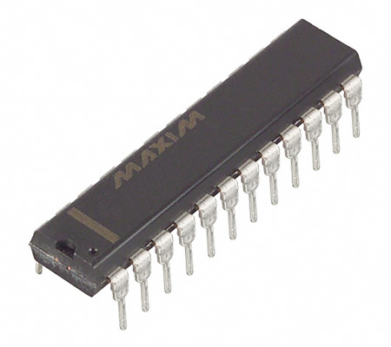
LED Grid
Parts to use:
MAX7219 24Pin DIP 8X8 grid LED Driver
Standard 20mA LEDs

Slide 17
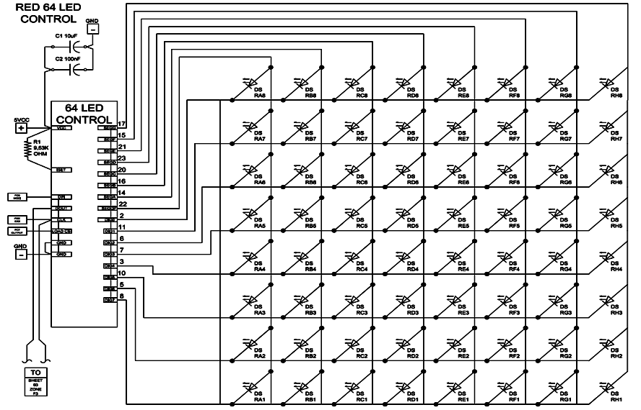
LED Grid

Slide 18
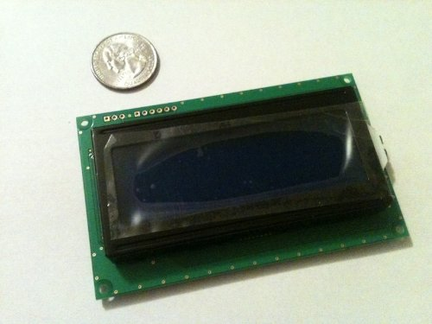
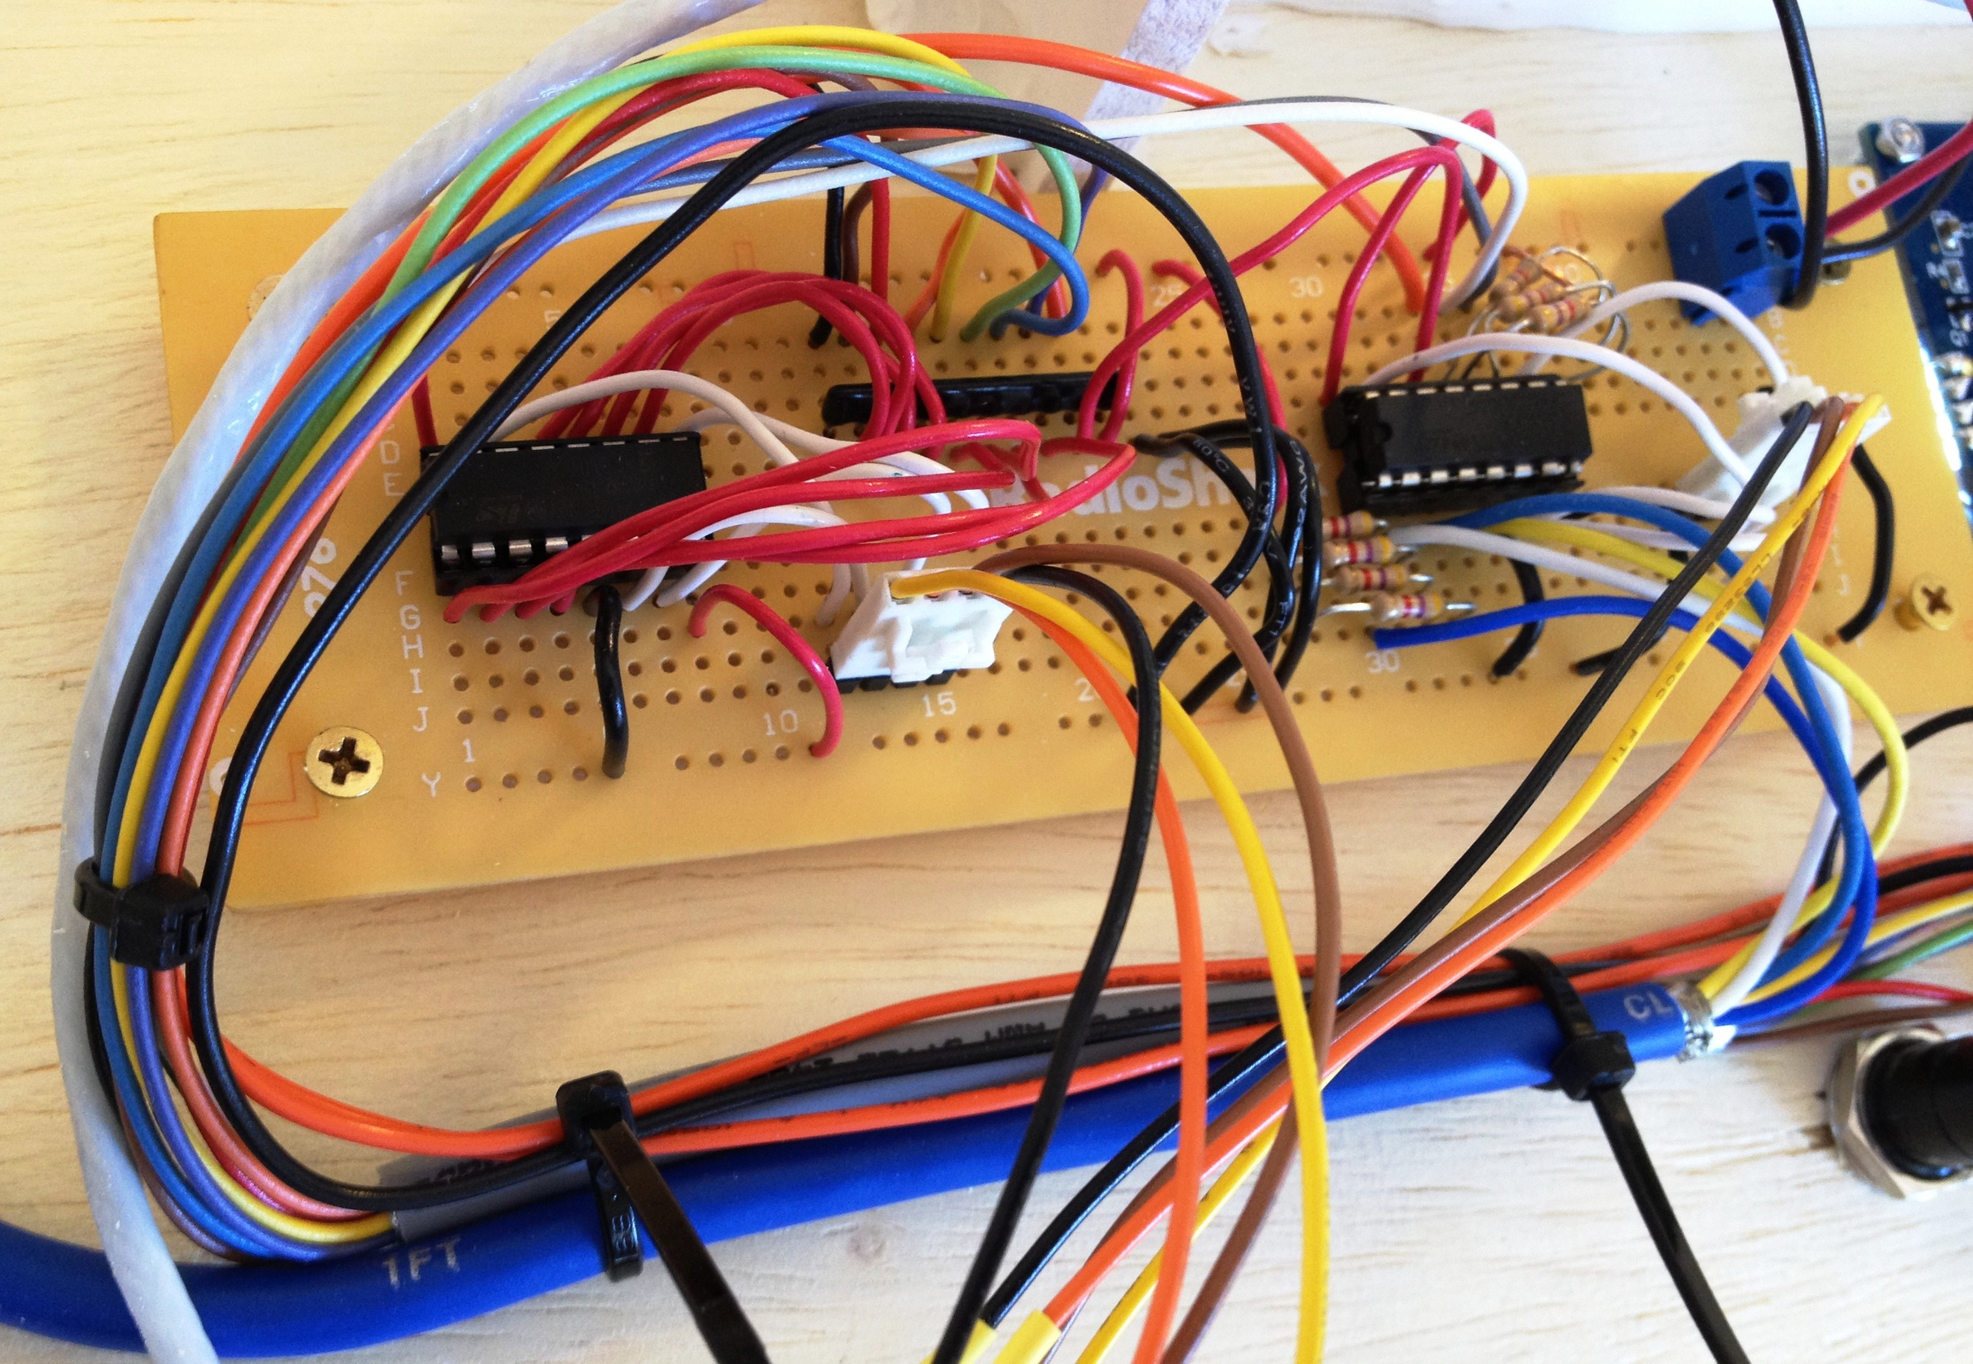
User Interface
Displays messages
Prompts the user
Informs the user
Serial LCD Module 20x4 Blue with White Backlight for Arduino

Slide 19
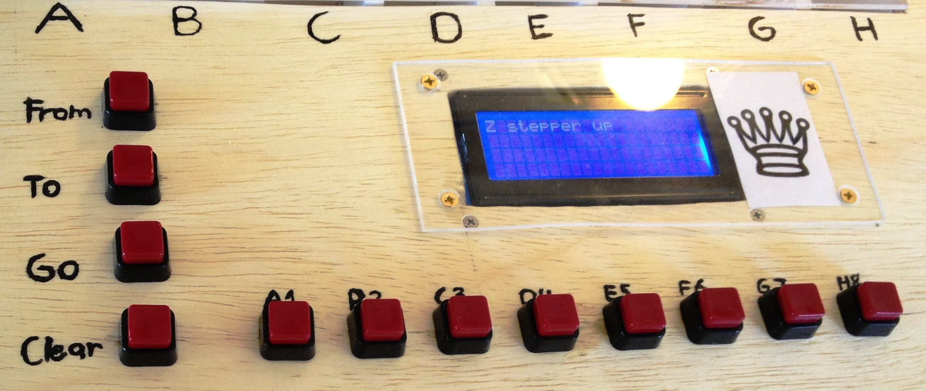
User Interface
Has buttons for input selections

Slide 20
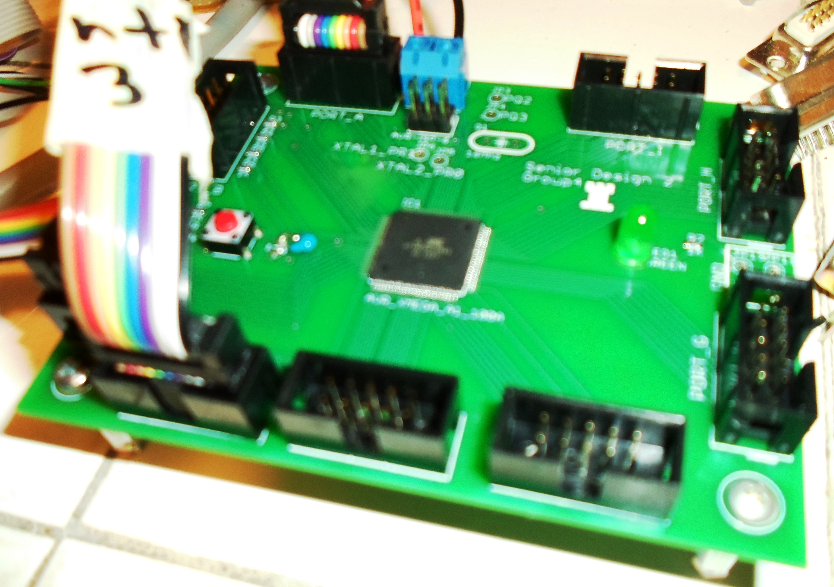
Microcontroller Requirements
Must run an onboard minimalist chess engine
Large development community
Easy access to dev tools.

Slide 21
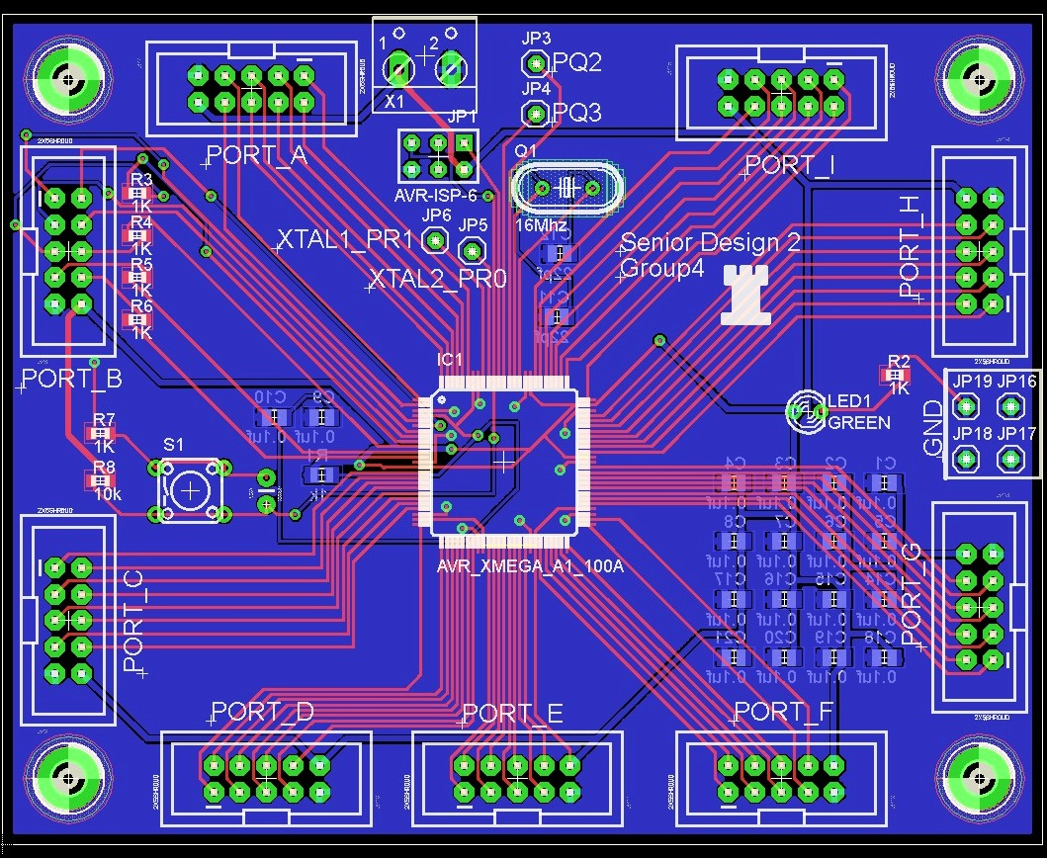
Microcontroller Specifications
60 I/O pins
4 hardware timers
4 USART
60 KB flash
4 KB SRAM

Slide 22
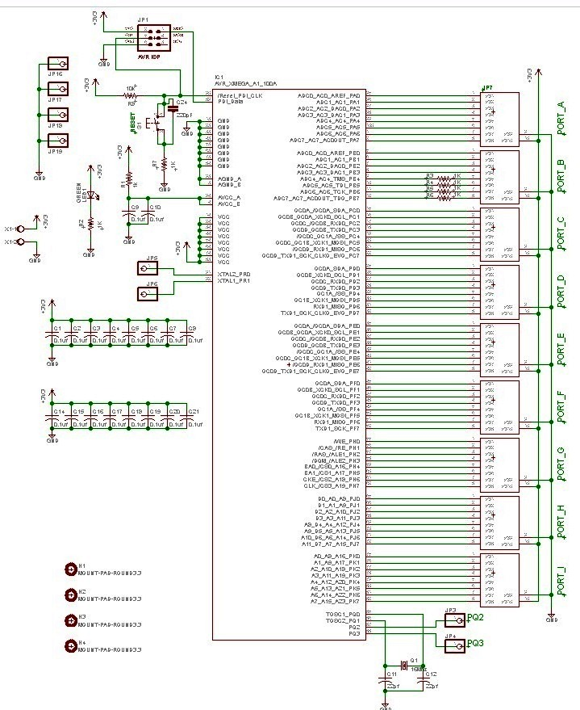
Microcontroller Schematic

Slide 23
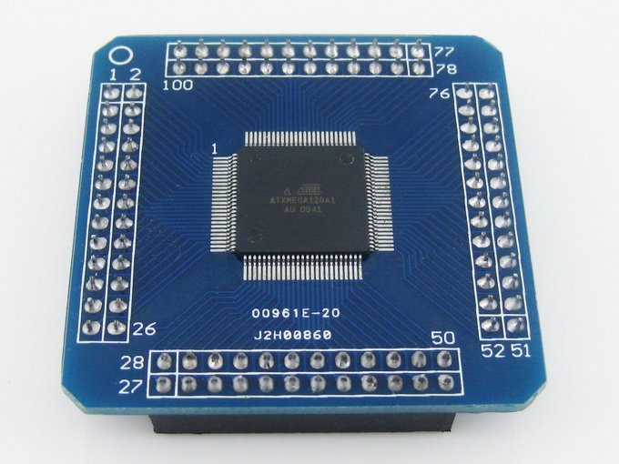
Xmega128A1
8KB SRAM
78 I/O pins
8 UART for Serial
8 Timers for PWM
128KB Flash memory
AVRFreaks support community
Atmel Tutorials, Atmel software suite

Slide 24
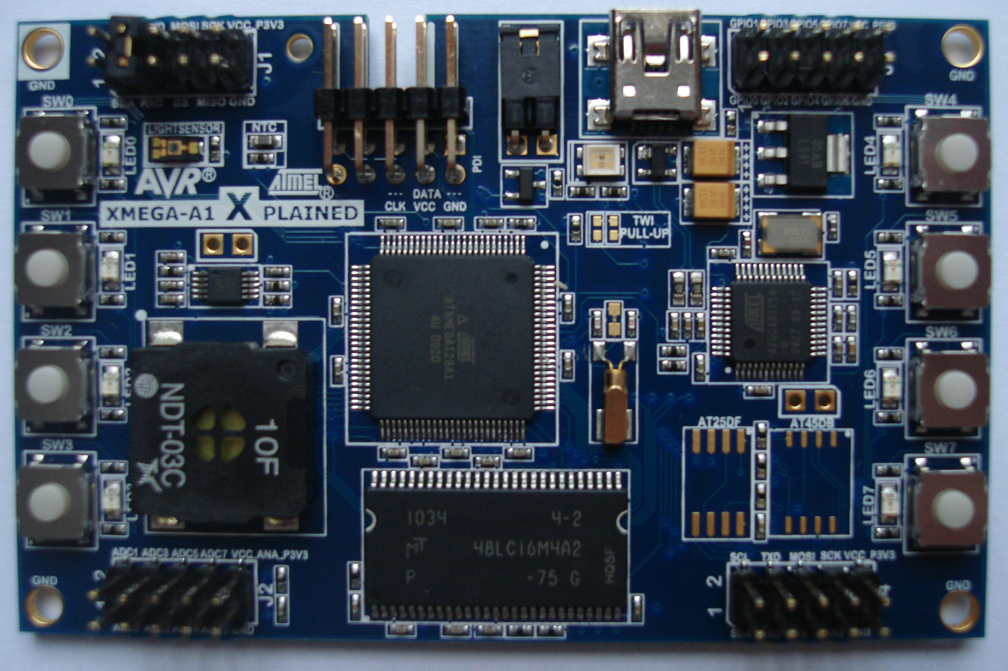
Development Tools
A1Xplained Board
For testing individual components
Atmel Studio
USB gateway
Had to program using Atmel FLIP
No debugging

Slide 25
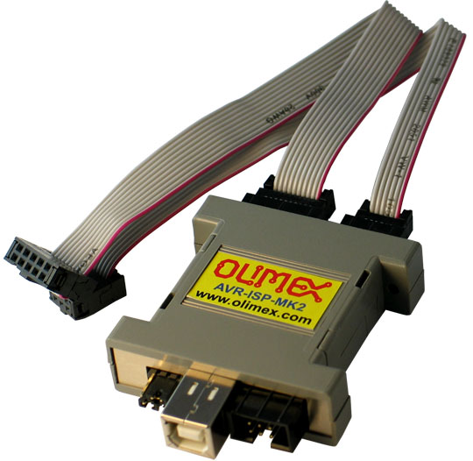
In System Programming
Ordered an AVR-ISP-MK2
Program in system with PDI

Slide 26
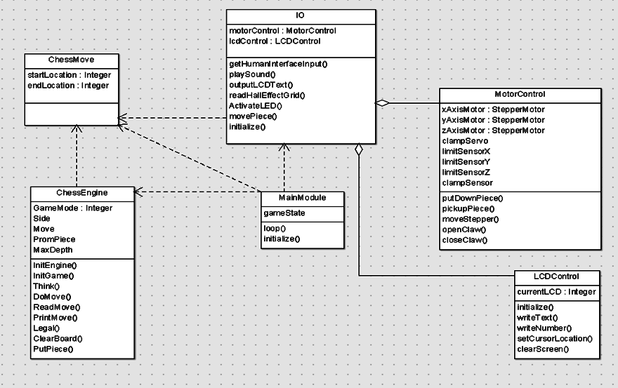
Software

Slide 27
Main Module

Slide 28
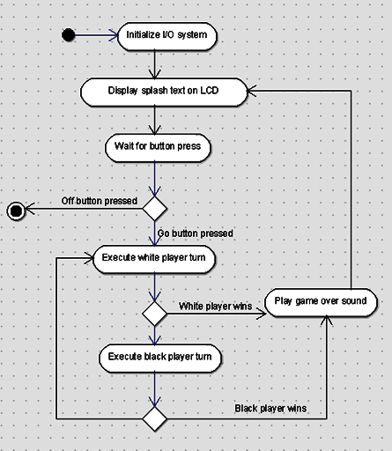
Main Module
Use only high level method calls
Describes high level gameplay process
Orchestrates interaction between I/O and Engine
Translates “moves” between chess engine and I/O module representations

Slide 29
Chess Module

Slide 30
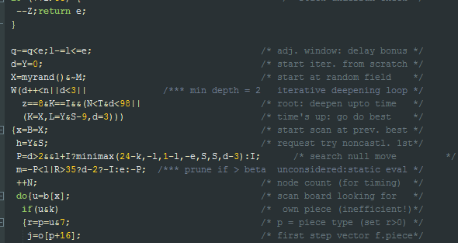
Chess Module
Contains internal state of chess game
Accepts player moves and creates AI moves
Should use < 4 KB RAM
Micro-Max open source chess engine
Smallest chess engine in the world
Our goal was not to understand, but to interface.

Slide 31
I/O Module

Slide 32
I/O Module
Contains functions to interface with individual I/O devices
Exposes high level interface to main module

Slide 33
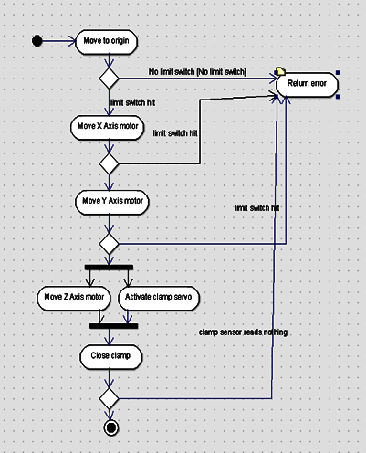
Motor Controller
All motor I/O functions grouped together
High level interface including “move piece”

Slide 34
Test Framework
Created test suite
Unit tests
LCD test
LED grid test
Individual Motor tests
Integration tests
HMI integration test
AI Integration test
Full play test

Slide 35
Test Plan
We developed a written test plan to check everything against
Acceptance Test Plan (ATP) where the Acceptance Test Results (ATR) are the final test results

Slide 36
Problems that Occurred
Repeatability
Binding
Integration issues
Actually putting everything on/beneath the board
Wiring the LED lighting grid
Eccentric gear concept
Replaced with a spool for Z axis
Vibration
LCD screen

Slide 37
What Didn’t Make It: Hall Effect Sensor Grid
Original Purpose:
For the microcontroller to understand where the chess pieces are Hall Effect sensors would have been placed under the board and grave yard.
The sensors would read whether or not the chess piece, which originally had a magnet embedded into it, is on particular squares.

Slide 38
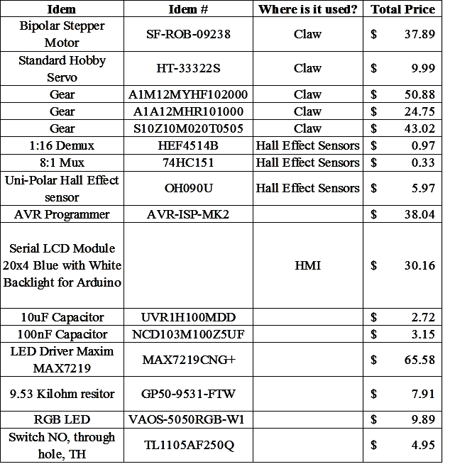
Budget

Slide 39
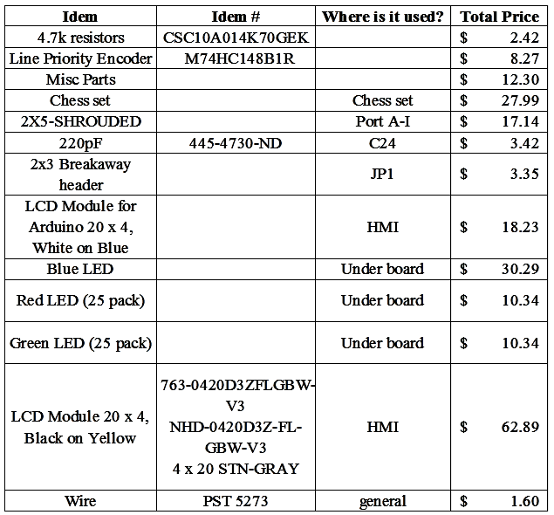
Budget

Slide 40

Total Spent
$544.80

Slide 41


Sponsors
Igus
Allied Electronics

Slide 42
Work Distribution

